Slide 1
PROJECT AND TERM PAPER
NAME: DHRUBAJYOTI PATRA
ROLL NUMBER: 002011701088
SEMESTER: 1ST YEAR: 3RD
SESSION: 2022-2023
DEPT: PRODUCTION ENGINEERING
JADAVPUR UNIVERSITY
Under the guidance of Professor Soumya Sarkar
Retrieval based Question and Answer Chatbot

Slide 2
INTRODUCTION
Chatbot :
At the most basic level, a chatbot is a computer program that simulates and processes human conversation (either written or spoken), allowing humans to interact with digital devices as if they were communicating with a real person. Chatbots can be as simple as rudimentary programs that answer a simple query with a single-line response, or as sophisticated as digital assistants that learn and evolve to deliver increasing levels of personalization as they gather and process information.
Chatbot
Generative Chatbots
Retrieval based Chatbots
The generative chatbot is the more complex of the two, since the task of generating new sentences is far more taxing and requires much more data to learn than simply retrieving a pre-written sentences.
For creating a retrieval-based bot is to have a model which ranks how appropriate all predefined responses are to a given input and then replies with the highest ranked.

Slide 3
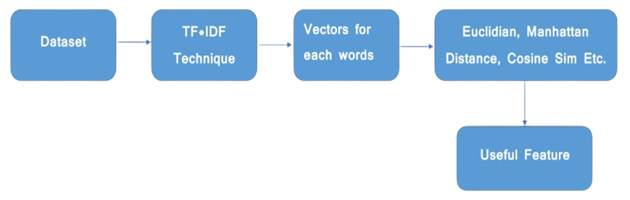
Basic architecture of a retrieval based chatbot

Slide 4
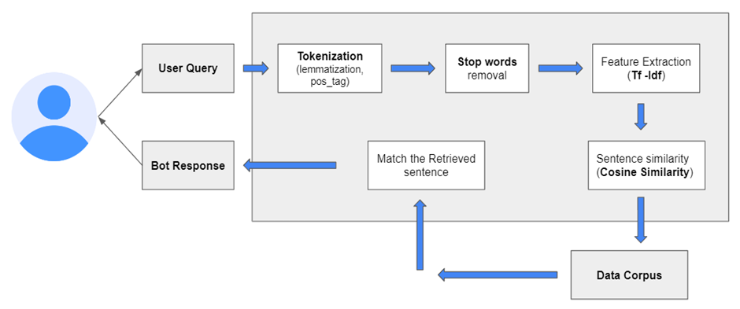
The aim of this project is to make a retrieval based Question and Answer chatbot for 1st and 2nd year students which will answer their queries related to production department and in the upcoming years with increase in the data corpus this chatbot will be able to provide more accurate and wide variety of answers to the users in that instant only so that they do not have to wait and search for a person from whom they can clear their queries
AIM
Fig: System architecture for the entire project

Slide 5
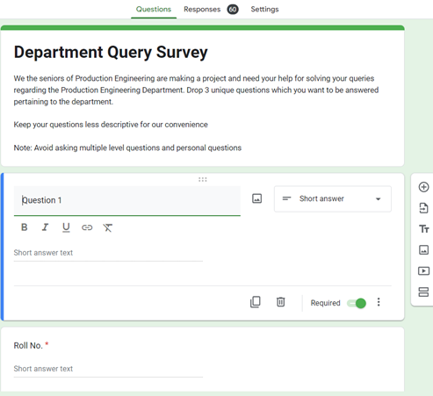
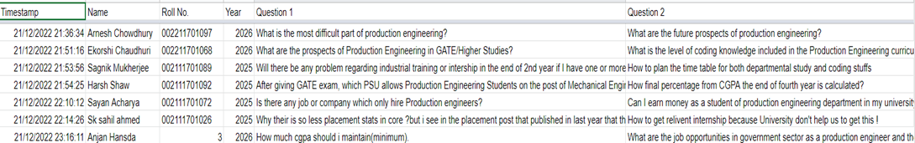
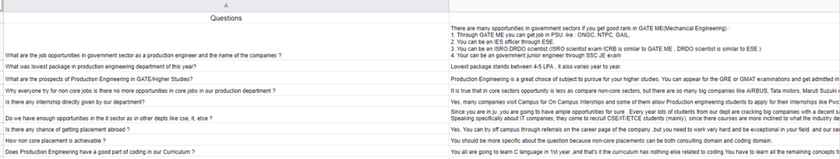
Dataset collection
Responses from Gform
Gform Circulation
Final data corpus of 127 Question and answer pair

Slide 6
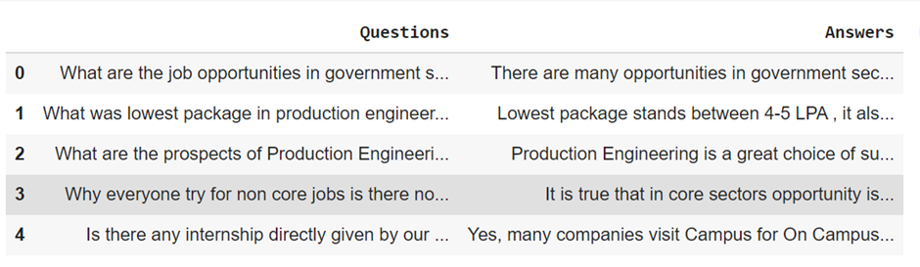
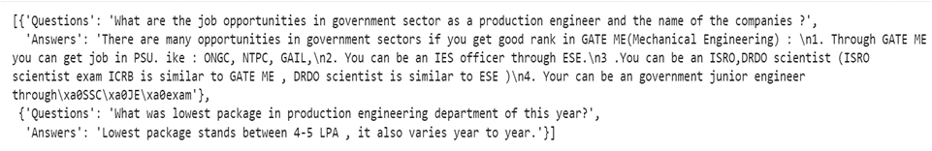
Conversion of data into json format
So in this project the data corpus containing 127 question and answer from csv file in converted into JSON file format.
JSON-formatted files have several benefits over CSV:
JSON maintains hierarchical structures, making it easier to hold related data in a single document and represent complex relationships.
Most programming languages provide native support for deserializing JSON into objects, or provide lightweight JSON serialization libraries.
JSON supports lists of objects, helping to avoid messy translations of lists into a relational data model.
Csv format dataframe
Json format data corpus

Slide 7
Tokenization:
It is the process by which a large quantity of text is divided into smaller parts called tokens. These tokens are very useful for finding patterns and are considered as a base step for stemming and lemmatization
Lemmatization
Lemmatization in NLTK is the algorithmic process of finding the lemma of a word depending on its meaning and context. Lemmatization usually refers to the morphological analysis of words, which aims to remove inflectional endings. It helps in returning the base or dictionary form of a word known as the lemma.
Pos_tag:
POS Tagging (Parts of Speech Tagging) is a process to mark up the words in text format for a particular part of a speech based on its definition and context. It is responsible for text reading in a language and assigning some specific token (Parts of Speech) to each word.
Stop Words
The stop words are removed from the sentences to extract important keyword. It is mainly employed to remove unnecessary things such as words occurring too frequently in sentences. It is also used to delete words that are not important or the words with no specific meanings such as an, a, or the. This step is applied to reduce processing time or computational complexity.
Example:
Input: Everything to permit us.
Output: [(‘Everything’, NN), (‘to’, TO), (‘permit’, VB), (‘us’, PRP)]

Slide 8



Feature Extraction
It is used to extract the set of keywords and frequency of the keywords in the document. The process of feature extraction is useful when you need to reduce the number of resources needed for processing without losing important or relevant information
Tf-Idf : Term frequency and Inverse document frequency is used to calculate the weight of each term in the sentence
The term frequency is used to check how many times the term as been occurred in a particular sentence using the formula below.
IDF used to compute the weight of uncommon words over all reports in the document. The words that appear in a while in the document have a high IDF score. It is given by the condition underneath where N is representing the no. of questions.
The tf and idf are combined to produce the weight of the term or word in the document. The tf and idf values are multiplied to obtain the weight of each term in the document.

Slide 9
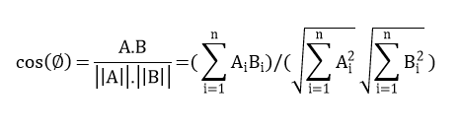
Cosine similarity
Cosine similarity is been used to check the similarity between two sentences. Cosine similarity measures the similarity between two vectors of an inner product space. It is measured by the cosine of the angle between two vectors and determines whether two vectors are pointing in roughly the same direction. It is often used to measure document similarity in text analysis. The similarity between the query and document is directly proportional to the number of query weights.
Example: - Consider an example to find the similarity between two vectors – ‘x’ and ‘y’, using Cosine Similarity.
The ‘x’ vector has values, x = {3, 2, 0, 5} The ‘y’ vector has values, y = {1, 0, 0, 0}
x . y = 3*1 + 2*0 + 0*0 + 5*0 = 3
||x|| = √ (3) ^2 + (2)^2 + (0)^2 + (5) ^2 = 6.16 ||y|| = √ (1) ^2 + (0)^2 + (0)^2 + (0)^2 = 1
∴ Cos(x, y) = 3 / (6.16 * 1) = 0.49
The dissimilarity between the two vectors ‘x’ and ‘y’ is given by –
∴ Dis(x, y) = 1 - Cos(x, y) = 1 - 0.49 = 0.51

Slide 10
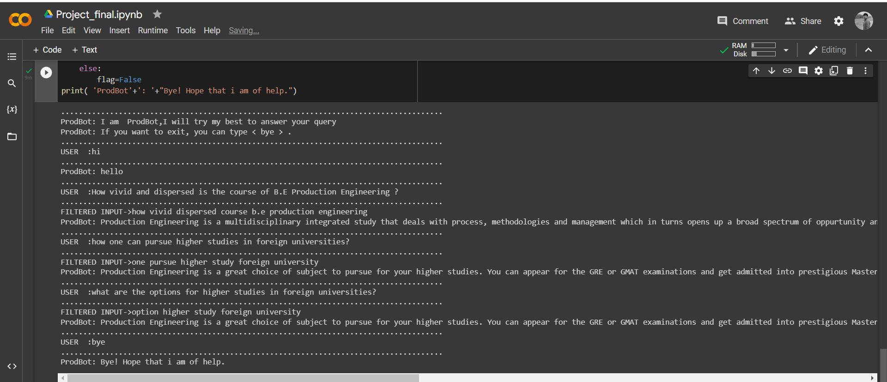
RESULTS
RUN 1 :
So here basically the bot is starting the conversation with randomly generating greeting responses from some hard coded greeting inputs and responses. Then for other queries it is retrieving answers from the corpus for the questions which are most similar to the user query and has the highest similarity score. Finally if the user enters bye then the bot ends the conversations.

Slide 11
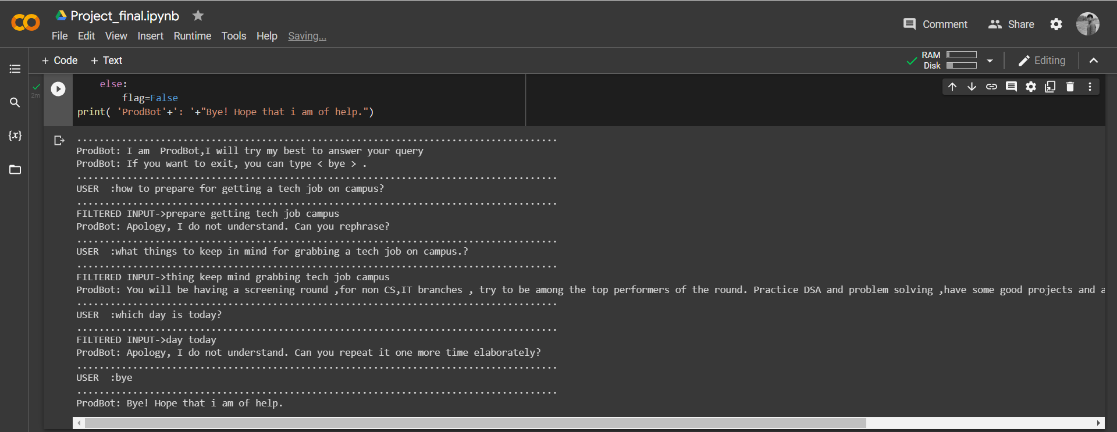
RUN 2 :
Here for the 1st and 3rd query the bot is showing to different responses apart from answers because query1 is falling under threshold B and query2 is falling under threshold A . So basically if the max cosine similarity score of the user query is 0 then it comes under ‘Threshold A’ and if the max cosine similarity score is less than 0.5 than it comes under ‘Threshold B’ and if the max cosine similarity score is greater than 0.5 then it comes under ‘Threshold C’.
For threshold A the bot will ask to repeat it more elaborately , for threshold B it will ask to rephrase because there is a chance of getting more cosine similarity score by rephrasing it and for threshold c it will give response as an answer to question which max similarity score with the user query.

Slide 12
CONCLUSION
Here we developed a platform using the TF-IDF for extracting the keyword after lemmatization, part of speech tagging and the removal of stop words from the user query which is displayed in the final results as filtered text. Each keyword is weighed down to obtain the proper answer for the query. The interface is developed for the users, to the input query in the google Colab. The code will be improved with the retrieving of answers consequently for the questions meaning increasing the data corpus for more accurate and wide variety of answers.

Slide 13
Thank You

